Slide 1
Police
Notes:
Produced by Victoria Legal Aid
Victoria Legal Aid
Level 9, 570 Bourke Street Melbourne VIC 3000
For free information about the law and how we can help you, please visit our website www.legalaid.vic.gov.au or call 1300 792 387
For business queries, call (03) 9269 0234
First edition January 2017, minor edits 2019
Acknowledgments: We thank AMES for their input into the original version of this resource.
© 2019 Victoria Legal Aid.
This work is licensed under a Creative Commons Attribution 4.0 licence. You are free to re-use the work under that licence, on the condition that you credit Victoria Legal Aid as author, indicate if changes were made and comply with other licence terms. The licence does not apply to any images, photographs or branding including the Victoria Legal Aid logo.
Disclaimer: The material in this publication is a general guide only. It is not legal advice. If you need to, please get legal advice about your own particular situation.
Victoria Legal Aid
Victoria Legal Aid is a government-funded agency set up to ensure that people who cannot afford to pay for a private lawyer can get help with their legal problems. We provide free information for all Victorians, family dispute resolution for disadvantaged families, provide lawyers on duty in most courts and tribunals in Victoria, and fund legal representation for people who meet our eligibility criteria. We help Victorian people with legal problems about criminal matters, family breakdown, child protection, family violence, child support, immigration, social security, mental health, discrimination, guardianship and administration, tenancy and debt.
Changes to the law
The law changes all the time. To check for changes you can:
call Victoria Legal Aid’s Legal Help phone line on 1300 792 387
visit the Victoria Legal Aid website (www.legalaid.vic.gov.au).
1

Slide 2
Today’s session
We will look at:
police
rights and responsibilities
police questions
where to get help.

Slide 3
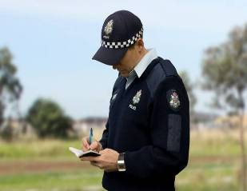
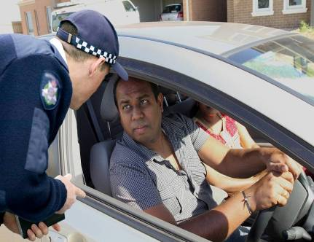
Police
Emergency: call 000.

Slide 4
Gahmal and Abdi
Gahmal Abdi

Slide 5
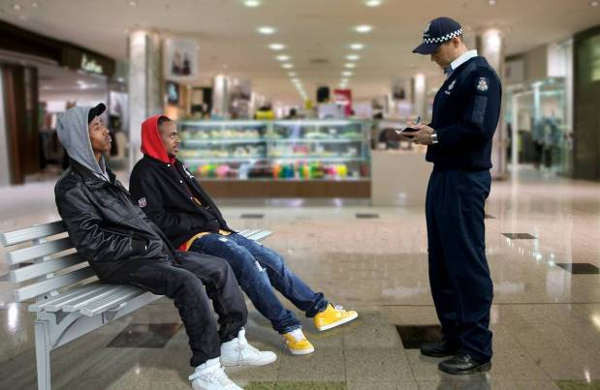
Name and address

Slide 6
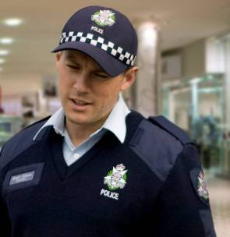
Correct information
The Prime Minister of Australia!

Slide 7
Other police questions
You can stay silent.
You can ask for a
lawyer, friend or
family member.

Slide 8
Police details
You can ask for:
name
rank
police station.

Slide 9
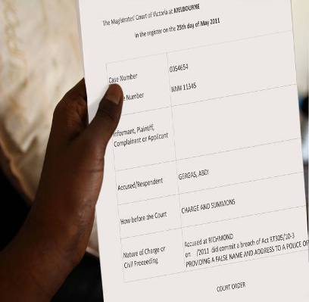
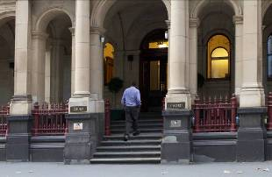
What can happen?

Slide 10
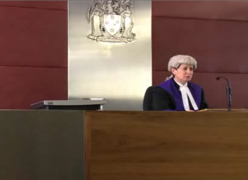
What happens at court?

Slide 11
True or false?
Police can ask Abdi for his name and address.
Abdi can give a fake name to police.
Abdi must answer all police questions.
Abdi can ask for the police officer’s details.
Abdi can complain if police treat him badly.

