Slide 1
About Victoria Legal Aid
Notes:
Produced by Victoria Legal Aid
Victoria Legal Aid
570 Bourke Street
Melbourne 3000
First edition February 2017
© 2017 Victoria Legal Aid.
This work is licensed under a Creative Commons Attribution 4.0 licence. You are free to re-use the work under that licence, on the condition that you credit Victoria Legal Aid as author, indicate if changes were made and comply with other licence terms. The licence does not apply to any images, photographs or branding including the Victoria Legal Aid logo.
1

Slide 2
What does Victoria Legal Aid do?
Notes:
Slide two: What does Victoria Legal Aid do?
We help Victorian people in a variety of ways. In the video, we mentioned that we provide free information and education for everyone in the community, and more intensive forms of help to those who need them most. In this part of the presentation, we will go into more detail about the forms/types of help that Victoria Legal Aid offers.
Key messages
We help Victorian people with their legal problems.
We help across a wide variety of legal areas.
We help individuals and we also work on changing the system.
For more detailed notes for this slide, see the About Victoria Legal Aid speakers’ notes.

Slide 3
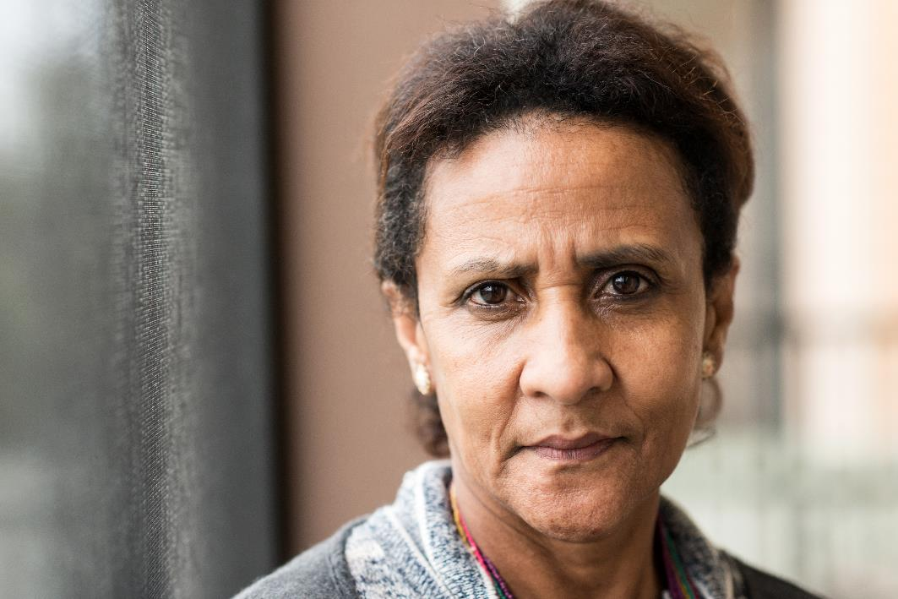
What can’t Victoria Legal Aid help people with?
Notes:
Slide three: What can’t Victoria Legal Aid help people with?
In this part of the presentation, we are going to go into more detail about the types of legal issues that Victoria Legal Aid provides no or limited help with.
Key messages
There are some legal matters that we provide no or limited help with.
You and your clients can still call us to find out who else can provide help.
For more detailed notes for this slide, see the About Victoria Legal Aid speakers’ notes.

Slide 4
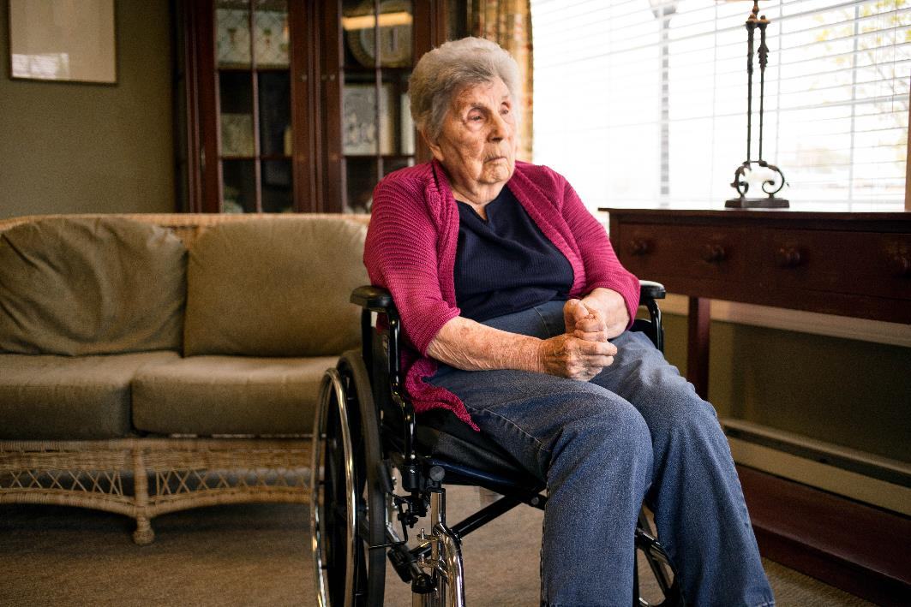
How do our lawyers work with clients?
Notes:
Slide four: How do our lawyers work with clients?
In the video, we talked about the various places where we can help people: at court, prisons and mental health facilities, and our offices and outreach locations. In this part of the presentation, we are going to talk about the different ways a lawyer works with a client. Your client may deal with receptionists and administrative staff too but we are going to focus on the work between a lawyer and a client. In a later part of the presentation we will talk about where clients can access our services.
Key messages
Generally, our lawyers work on the client’s instructions.
Our lawyers help in a variety of ways, from writing letters to appearing for your client in court.
Our lawyers can connect clients to other services too.
Our lawyers may help your client on a once-off basis or may be involved in an ongoing way with your client.
Sometimes we meet with clients in our offices.
Sometimes we are based where clients are.
For more detailed notes for this slide, see the About Victoria Legal Aid speakers’ notes.

Slide 5
What sort of people do we help?
Notes:
Slide five: What sort of people do we help?
In this part of the presentation, we are going to talk more about who we help. We will talk about our priority audiences.
Key messages
We help all Victorians but we provide different levels of services to different people.
Our more intensive services are for people facing serious consequences and people living on low incomes and with complex needs.
We triage and assess people’s legal problems to make a decision about the best way to assist them.
It is best for the person who has the legal problem to call through to our Legal Help phone service to find out exactly how we can help.
For more detailed notes for this slide, see the About Victoria Legal Aid speakers’ notes.

Slide 6
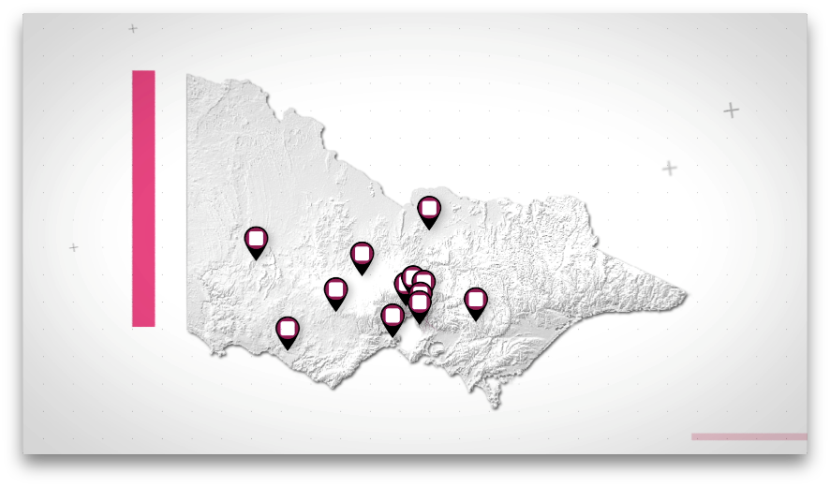
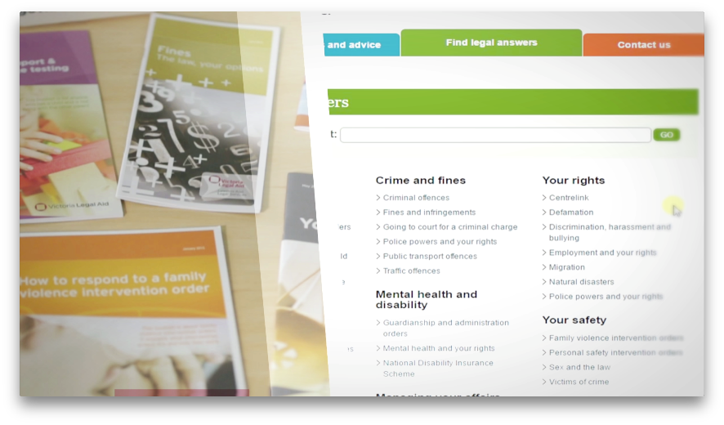
How can someone contact us?
Notes:
Slide six: How can someone contact us?
In the video, we talked about the four main ways that you access Victoria Legal Aid: our website, on the phone through our Legal Help, one of our offices, and at many courts and tribunals across Victoria. In this part of the presentation we are going to talk more about these access points.
Key messages
We have offices across the state.
We provide some services on site within other organisations.
We have a website and a phone line.
Clients can call or visit, or we may be visiting your clients where they are.
Some clients will have existing relationships with our lawyers.
Our services are free or low-cost.
For more detailed notes for this slide, see the About Victoria Legal Aid speakers’ notes.

Slide 7
What happens when someone contacts us?
Notes:
Slide seven: What happens when someone contacts us?
In the video, we talked about what someone can expect when they contact us:
getting accessible services for people who do not speak English or speak very little English
triaging and assessment process to work out what help is best for the person
getting information on the spot or linking a person with one of our services
referring people to other services or a community legal centre.
In this part of the presentation we are going to talk more about accessibility, our triaging and assessment, and internal and external referrals.
Key messages
We try to ensure that our services are accessible to people who speak no or little English, people with a disability and to Aboriginal and Torres Strait Islanders.
We assess and triage people for our more intensive services.
We may make a referral into our own organisation or refer someone out to another organisation.
For more detailed notes for this slide, see the About Victoria Legal Aid speakers’ notes.

Slide 8
How can we work with you?
Notes:
Slide eight: How can we work with you?
In the video, we focused on how Victoria Legal Aid supports clients. In this part of the presentation, we are going to talk about the ways we can work with you.
Key messages
We may work with you directly in relation to a shared client.
We can provide training to workers in other organisations on some areas of the law, with an emphasis on clients’ rights and responsibilities.
We work with partners like you to educate individuals in group settings, on issues that are likely to affect that group.
We can work together on projects and service delivery.
For more detailed notes for this slide, see the About Victoria Legal Aid speakers’ notes.

